Slide 1

Prof. George Gitau and Dr. Muasya
Dept of Clinical Studies

Slide 2
Economic importance
Serious problem in East and Central Africa
Causes major economic losses
  Death
  Acaricides
  Treatment

Slide 3
Etiology and Transmission
Caused by a protozoa Theileria parva
Transmitted Rhipicephalus appendiculatus ticks (brown ear tick)
Notes:
The signs of approaching parturition are generally similar but vary in certain respects from species to species. The symptoms could also be inconsistent between individuals within the same and also in the same individual with each pregnancy.

Slide 4
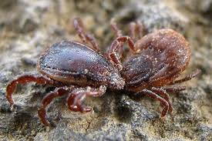


Slide 5
Clinical signs
  Fever occurs 7-10 days after infection
  Enlarged superficial LNs (Lymphadenopathy)
  Petechiae
  Cough
  Dyspnea
  Anorexia
  Lacrimation
  Nasal discharge
Death occurs 18-24 days after infection
Notes:
The udder becomes enlarged and edematous. This begins at about the fourth month of gestation in heifers, and is noticed in the last 2 to 4 weeks of parturition in pluriparous animals. The edema may be extensive in young animals and interfere with walking. It may extend from the udder to the xiphoid region i.e. physiological edema. It looks like a hernia in the umbilical region.
Just prior to parturition the udder secretion changes from a honey-like dry secretion to a yellow, turbid, opaque cellular secretion, i.e. colostrum.

Slide 6
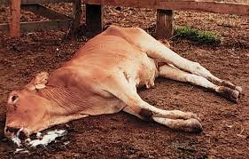
ECF in a cow

Slide 7
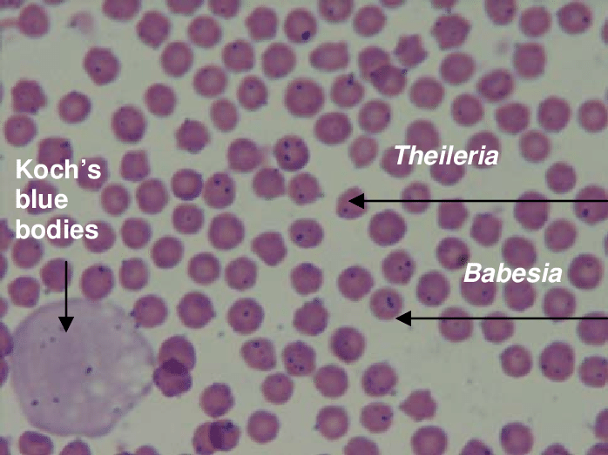
Blood slide

Slide 8
Treatment and Control
Parvaquone
Buparvaquone
Immunization infection-and-treatment
Rigid tick control with acaricides

Slide 9
Babesiosis

Slide 10
Definition
Redwater or cattle tick fever
Caused by Babesia spp - B. bovis and B. bigemina in cattle
Transmitted exclusively by ticks mainly Boophilus spp

Slide 11
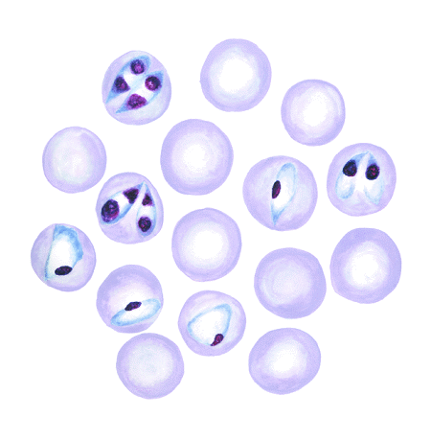
Babesia parasites in RBC-1

Slide 12
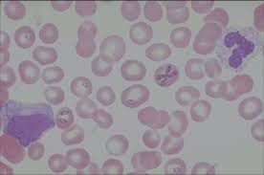
Babesia parasites in RBC-2

Slide 13
Clinical signs
Inapparent to acute severe diseases
  Fever
  Pale MM (due to anaemia)
  Haemoglobinuria (red urine)
  Depression
  Inappetence
  Jaudice (yellow MM)
Notes:
Hormonal factors are of prime importance as parturition can occur without innervation of the uterus.
Initiation of parturition starts in the hypothalamus of the fetal brain. This is probably in response to stimuli such as placental ageing, nutritional and uterine restrictions to growth, and accumulation of waste products. These stimuli (stressors) cause the fetal hypothalamus to release CRH, which causes release of ACTH from the pituitary gland and elevation of adrenal cortisol in the fetal and then maternal blood.

Slide 14
cont
Abortion
Incoordination
Paralysis
Coma (which often lead to death)
Notes:
Hormonal factors are of prime importance as parturition can occur without innervation of the uterus.
Initiation of parturition starts in the hypothalamus of the fetal brain. This is probably in response to stimuli such as placental ageing, nutritional and uterine restrictions to growth, and accumulation of waste products. These stimuli (stressors) cause the fetal hypothalamus to release CRH, which causes release of ACTH from the pituitary gland and elevation of adrenal cortisol in the fetal and then maternal blood.
Fetal cortisol activates the enzyme 17α hydroxylase
E2 enhances contractile power of the uterus by
Promoting synthesis of contractile proteins in uterine muscles
Increasing sensitivity of uterine muscles to oxytocin
Increasing sensitivity of the soft birth canal to other stimuli

Slide 15
Treatment
Imidocarb
Diminazene aceturate

Slide 16
Control measures
Young cattle should be vaccinated
Enforce strict tick control
Natural infection with babesiosis in calfhood, result to immunity

Slide 17
Trypanosomiasis

Slide 18
Definition
Protozoan infection of all domestic animals.
T. congolense T. vivax T. brucei brucei and T. simiae
T. brucei rhodesiense and T. brucei gambiense

Slide 19
Transmission
Mainly Tsetse fly of the Glossina family
Mechanical transmission can occur through tsetse or other biting flies

Slide 20
In the case of T vivax, Tabanus spp and other biting flies seem to be the primary mechanical vectors outside the tsetse areas

Slide 21
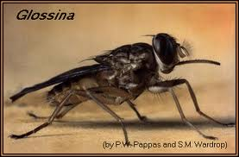
Tsetse Fly

Slide 22
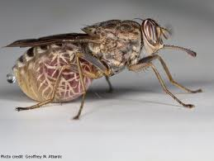
Tsetse fly

Slide 23
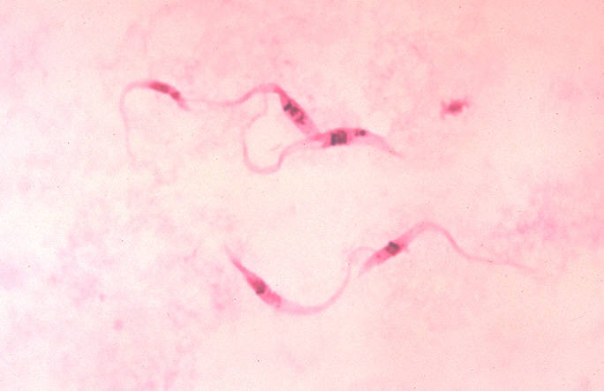
Parasites in blood

Slide 24
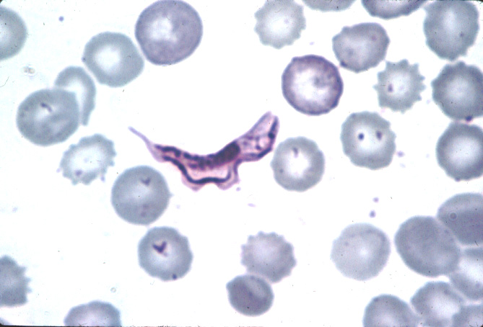

Slide 25
Clinical Signs
Fever
Enlarged LNs
Petechiae
Pale MM
Loss body condition
Blindness
Nasal discharge and lacrimation

Slide 26

Tryps in a cow

Slide 27
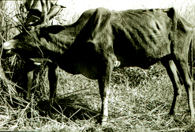

Slide 28
Treatment and control
Drugs
Diminazene - curative
Isometamidium - prophylaxis
Homidium bromide - curative
Homidium chloride - curative
Quinapyramine - curative
Suramin - curative
Vector control – spray, dipping, bush control, etc

